Slide 1

UNIVERSITY INSTITUTE OF ENGINEERING
COMPUTER SCIENCE ENGINEERING
Bachelor of Engineering (Computer Science & Engineering)
Subject Name: Big Data Analytics
Subject Code: 20CST-471
Distributed machine learning
Mapped with CO5
Prepared By:
Er. Ankita Sharma
DISCOVER . LEARN . EMPOWER

Slide 2
Distributed machine learning
Distributed machine learning refers to the use of multiple computing resources, often organized in a cluster or a distributed computing environment, to perform machine learning tasks. This approach is essential for handling large-scale datasets, complex models, and computationally intensive operations that cannot be efficiently processed on a single machine. The primary goals of distributed machine learning are to improve scalability, reduce processing time, and enable the handling of big data challenges.

Slide 3
1. Distributed Computing Frameworks:
Apache Spark: A popular open-source distributed computing framework that provides a unified analytics engine for large-scale data processing. Spark includes MLlib, a library for distributed machine learning.
TensorFlow and PyTorch: Popular deep learning frameworks that can be configured to work in a distributed manner, allowing the training of deep neural networks across multiple GPUs or servers.
Dask: A parallel computing framework in Python that enables distributed computing for machine learning and other data-intensive tasks.
Hadoop MapReduce: While not as commonly used for machine learning as Spark, Hadoop MapReduce can also be adapted for distributed machine learning tasks.

Slide 4
2. Parallelism and Data Distribution:
Data Parallelism: Distributing the dataset across multiple nodes or machines and performing parallel computation on different subsets of the data. Each machine processes a portion of the data independently.
Model Parallelism: Distributing the components of a model across different machines, where each machine is responsible for computing specific parts of the model.

Slide 5
Distributed machine learning refers to the use of multiple computing resources, often organized in a cluster or a distributed computing environment, to perform machine learning tasks. This approach is essential for handling large-scale datasets, complex models, and computationally intensive operations that cannot be efficiently processed on a single machine. The primary goals of distributed machine learning are to improve scalability, reduce processing time, and enable the handling of big data challenges.
Here are key concepts and aspects related to distributed machine learning:
1. Distributed Computing Frameworks:
Apache Spark: A popular open-source distributed computing framework that provides a unified analytics engine for large-scale data processing. Spark includes MLlib, a library for distributed machine learning.
TensorFlow and PyTorch: Popular deep learning frameworks that can be configured to work in a distributed manner, allowing the training of deep neural networks across multiple GPUs or servers.

Slide 6
3. Communication and Synchronization:
Parameter Server Architectures: In distributed machine learning, parameter servers are used to manage and distribute model parameters across the cluster. Workers perform computations and update the parameters by communicating with the parameter server.
Synchronization Strategies: Ensuring that the different components of the distributed system are synchronized is crucial. Strategies include synchronous updates, asynchronous updates, and a combination of both.

Slide 7
4. Scaling Algorithms:
Horizontal Scaling: Increasing the number of machines or nodes in the cluster to handle larger datasets and more complex models.
Vertical Scaling: Utilizing more powerful hardware or increasing the computational capacity of individual machines.
5. Fault Tolerance:
Distributed machine learning systems need to be resilient to failures in the cluster. Techniques such as data replication, checkpointing, and fault-tolerant algorithms are employed to handle failures gracefully.

Slide 8
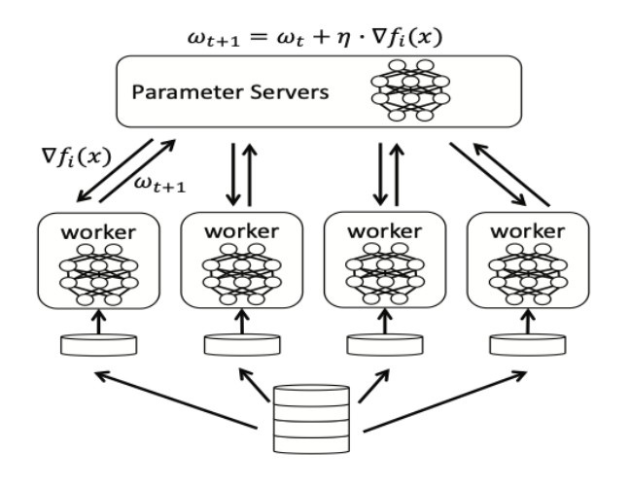

Slide 9
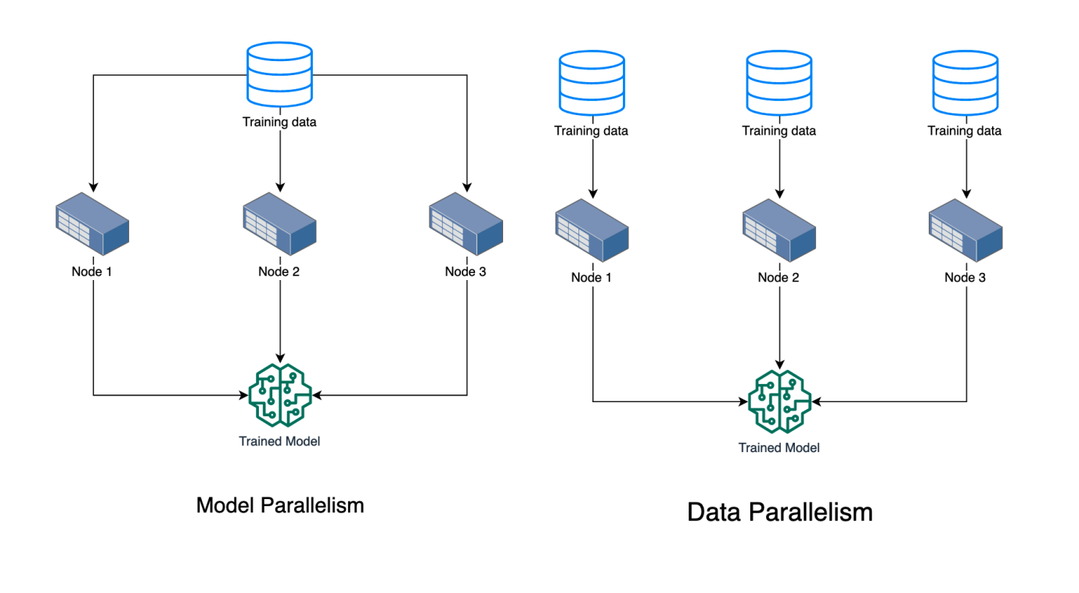

Slide 10
Thankyou

